Slide 1
IO AND FILE HANDLING

Slide 2
Objective
IO Stream class Hierarchy
What are Streams?
Understand streams and the classes provided by framework for interacting with streams
What are and How to use Readers and Writers?
StreamWriter, StreamReader,
BinaryWriter, BinaryReader
Work with Path, File, Directory, FileInfo, DirectoryInfo classes

Slide 3
.NET IO Class Hierarchy
Object
BinaryReader
MarshalByRefObjcet
Directory
File
Path
BinaryWriter
FileSystemInfo
Stream
Abstract Class
Abstract Class
MemoryStream
FileInfo
DirectoryInfo
FileStream
BufferedStream
Abstract Class
Abstract Class
TextReader
TextWriter
StreamReader
StreamWriter
Notes:
File handling is common operation and facilities related to it has been provided in every programming language, including C#.

Slide 4
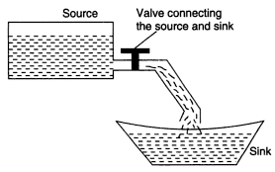
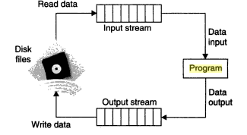
Streams
A stream is an abstraction of a sequence of bytes, such as a file, an input/output device, an inter-process communication pipe, or a TCP/IP socket.
Streams involve three fundamental operations
You can read from streams.
You can write to streams.
Streams can support seeking
In .NET, Stream is the abstract base class of all streams.
.
Conceptual view of a stream
File input and output stream
Notes:
The Stream class and its derived classes provide a generic view of these different types of input and output, and isolate the programmer from the specific details of the operating system and the underlying devices.
Streams involve three fundamental operations
You can read from streams. Reading is the transfer of data from a stream into a data structure, such as an array of bytes.
You can write to streams. Writing is the transfer of data from a data structure into a stream.
Streams can support seeking. Seeking refers to querying and modifying the current position within a stream. Seek capability depends on the kind of backing store a stream has. For example, network streams have no unified concept of a current position, and therefore typically do not support seeking.

Slide 5
Useful Methods of Stream class
Method | Description
Read | When overridden in a derived class, reads a sequence of bytes from the current stream and advances the position within the stream by the number of bytes read.
Seek | When overridden in a derived class, sets the position within the current stream.
Write | When overridden in a derived class, writes a sequence of bytes to the current stream and advances the current position within this stream by the number of bytes written.
WriteByte | Writes a byte to the current position in the stream and advances the position within the stream by one byte.
ReadByte | Reads a byte from the stream and advances the position within the stream by one byte, or returns -1 if at the end of the stream
Flush | When overridden in a derived class, clears all buffers for this stream and causes any buffered data to be written to the underlying device.
Close | Closes the current stream and releases any resources (such as sockets and file handles) associated with the current stream. Instead of calling this method, ensure that the stream is properly disposed.

Slide 6
Useful properties of Stream class
Property | Description
Length | When overridden in a derived class, gets the length in bytes of the stream.
Position | When overridden in a derived class, gets or sets the position within the current stream.
CanRead | When overridden in a derived class, gets a value indicating whether the current stream supports reading.
CanWrite | When overridden in a derived class, gets a value indicating whether the current stream supports writing.
CanSeek | When overridden in a derived class, gets a value indicating whether the current stream supports seeking.

Slide 7
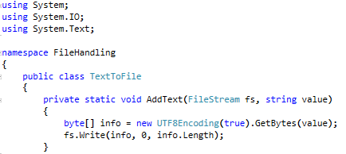
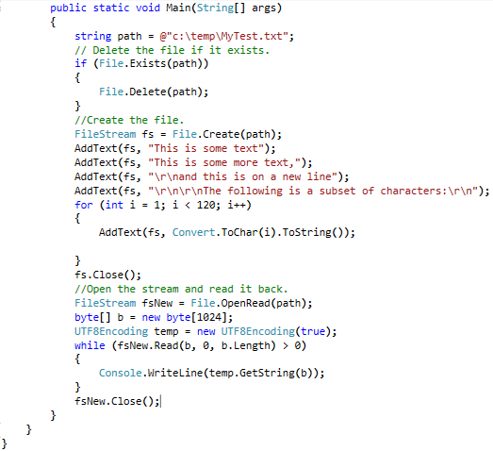
FileStream
FileStream Class:
Exposes a Stream around a file, supporting both synchronous and asynchronous read and write operations.
Notes:
Note:
Use the FileStream class to read from, write to, open, and close files on a file system, as well as to manipulate other file-related operating system handles including pipes, standard input, and standard output. You can specify read and write operations to be either synchronous or asynchronous. FileStream buffers input and output for better performance.
FileStream objects support random access to files using the Seek method. Seek allows the read/write position to be moved to any position within the file. This is done with byte offset reference point parameters. The byte offset is relative to the seek reference point, which can be the beginning, the current position, or the end of the underlying file, as represented by the three properties of the SeekOrigin class.

Slide 8
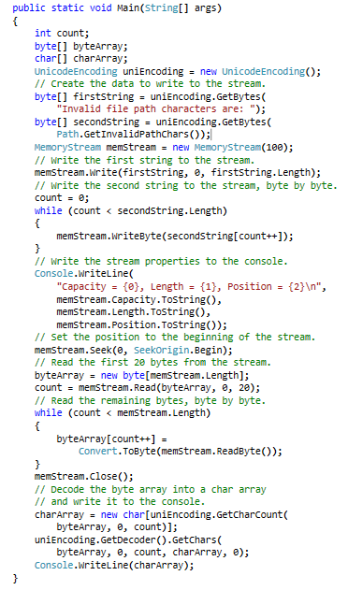
MemoryStream
Creates a stream whose backing store is memory.
Memory streams created with an unsigned byte array provide a non-resizable stream of the data.
Notes:
Note:
The current position of a stream is the position at which the next read or write operation could take place. The current position can be retrieved or set through the Seekmethod. When a new instance of MemoryStream is created, the current position is set to zero.
Memory streams created with an unsigned byte array provide a non-resizable stream of the data. When using a byte array, you can neither append to nor shrink the stream, although you might be able to modify the existing contents depending on the parameters passed into the constructor. Empty memory streams are resizable, and can be written to and read from.

Slide 9
BufferedStream
A buffer is a block of bytes in memory used to cache data, thereby reducing the number of calls to the operating system.
Buffers improve read and write performance.
A buffer can be used for either reading or writing, but never both simultaneously.
BufferedStream class adds a buffering layer to read and write operations on another stream. This class cannot be inherited.
The Read and Write methods of BufferedStream automatically maintain the buffer.
Notes:
Faculty Note:
Example of buffered stream is not given, since at this point that might be difficult to understand
Note:
BufferedStream can be composed around certain types of streams.
It provides implementations for reading and writing bytes to an underlying data source or repository. Use BinaryReader and BinaryWriter for reading and writing other data types.
BufferedStream is designed to prevent the buffer from slowing down input and output when the buffer is not needed.
If you always read and write for sizes greater than the internal buffer size, then BufferedStream might not even allocate the internal buffer.
BufferedStream also buffers reads and writes in a shared buffer.
It is assumed that you will almost always be doing a series of reads or writes, but rarely alternate between the two of them.

Slide 10
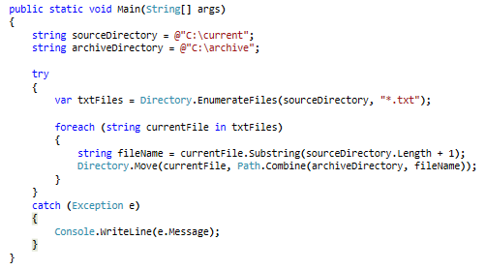
Directory
Exposes static methods for creating, moving, and enumerating through directories and subdirectories.
This class cannot be inherited.
Notes:
Note:
Use the Directory class for typical operations such as copying, moving, renaming, creating, and deleting directories.
To create a directory, use one of the CreateDirectory methods.
To delete a directory, use one of the Delete methods.
To get or set the current directory for an app, use the GetCurrentDirectory or SetCurrentDirectory method.
To manipulate DateTime information related to the creation, access, and writing of a directory, use methods such as SetLastAccessTime and SetCreationTime.
The static methods of the Directory class perform security checks on all methods. If you are going to reuse an object several times, consider using the corresponding instance method of DirectoryInfo instead, because the security check will not always be necessary.
If you are performing only one directory-related action, it might be more efficient to use a static Directory method rather than a corresponding DirectoryInfo instance method. Most Directory methods require the path to the directory that you are manipulating.

Slide 11
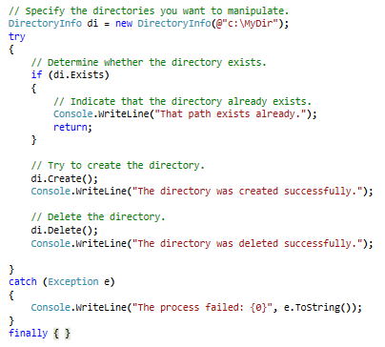
DirectoryInfo
Exposes instance methods for creating, moving, and enumerating through directories and subdirectories.
This class cannot be inherited.
Notes:
Note:
Use the DirectoryInfo class for typical operations such as copying, moving, renaming, creating, and deleting directories.
If you are going to reuse an object several times, consider using the instance method of DirectoryInfo instead of the corresponding static methods of the Directory class, because a security check will not always be necessary.

Slide 12
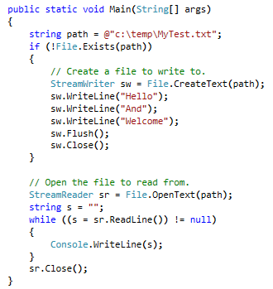
File
Provides static methods for the creation, copying, deletion, moving, and opening of a single file, and aids in the creation of FileStream objects
Because all File methods are static, it might be more efficient to use a File method
By default, full read/write access to new files is granted to all users.
Notes:
Note:
Use the File class for typical operations such as copying, moving, renaming, creating, opening, deleting, and appending to a single file at a time. You can also use the Fileclass to get and set file attributes or DateTime information related to the creation, access, and writing of a file. If you want to perform operations on multiple files, seeGetFiles or GetFiles.
Many of the File methods return other I/O types when you create or open files. You can use these other types to further manipulate a file.
The static methods of the File class perform security checks on all methods. If you are going to reuse an object several times, consider using the corresponding instance method of FileInfo instead, because the security check will not always be necessary.

Slide 13
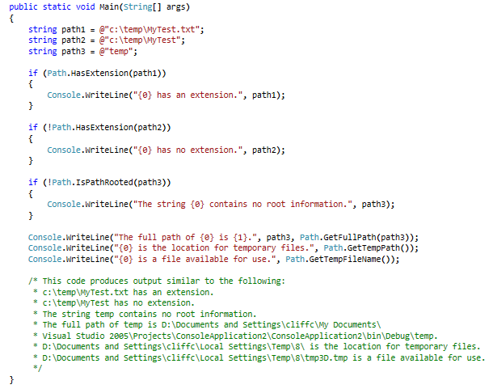
Path
Performs operations on String instances that contain file or directory path information.
These operations are performed in a cross-platform manner.
Notes:
Note:
The .NET Framework does not support direct access to physical disks through paths that are device names, such as "\\.\PHYSICALDRIVE0 ".
A path is a string that provides the location of a file or directory. A path does not necessarily point to a location on disk; for example, a path might map to a location in memory or on a device. The exact format of a path is determined by the current platform. For example, on some systems, a path can start with a drive or volume letter, while this element is not present in other systems. On some systems, file paths can contain extensions, which indicate the type of information stored in the file. The format of a file name extension is platform-dependent; for example, some systems limit extensions to three characters, and others do not. The current platform also determines the set of characters used to separate the elements of a path, and the set of characters that cannot be used when specifying paths. Because of these differences, the fields of the Pathclass as well as the exact behavior of some members of the Path class are platform-dependent.
A path can contain absolute or relative location information. Absolute paths fully specify a location: the file or directory can be uniquely identified regardless of the current location. Relative paths specify a partial location: the current location is used as the starting point when locating a file specified with a relative path.
Most members of the Path class do not interact with the file system and do not verify the existence of the file specified by a path string.
The members of the Path class enable you to quickly and easily perform common operations such as determining whether a file name extension is part of a path, and combining two strings into one path name.

Slide 14
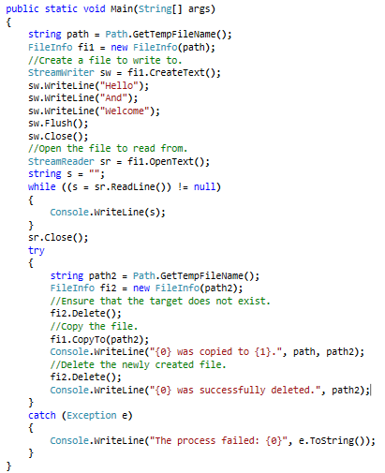
FileInfo
Provides properties and instance methods for the creation, copying, deletion, moving, and opening of files, and aids in the creation of FileStream objects.
This class cannot be inherited.
Notes:
Use the FileInfo class for typical operations such as copying, moving, renaming, creating, opening, deleting, and appending to files.
If you are performing multiple operations on the same file, it can be more efficient to use FileInfo instance methods instead of the corresponding static methods of the Fileclass, because a security check will not always be necessary.
Many of the FileInfo methods return other I/O types when you create or open files. You can use these other types to further manipulate a file.
By default, full read/write access to new files is granted to all users.

Slide 15
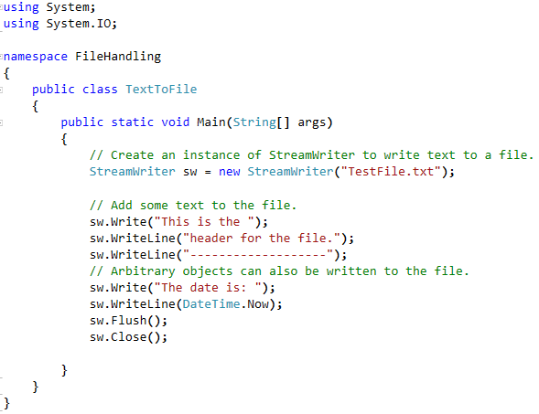
Writing Stream of Data in a File: StreamWriter class
StreamWriter: Implements a TextWriter for writing characters to a stream in a particular encoding.
Notes:
Note:
StreamWriter is designed for character output in a particular encoding, whereas classes derived from Stream are designed for byte input and output.
StreamWriter defaults to using an instance of UTF8Encoding unless specified otherwise. This instance of UTF8Encoding is constructed without a byte order mark (BOM), so its GetPreamble method returns an empty byte array. The default UTF-8 encoding for this constructor throws an exception on invalid bytes. This behavior is different from the behavior provided by the encoding object in the Encoding.UTF8 property. To specify a BOM and determine whether an exception is thrown on invalid bytes, use a constructor that accepts an encoding object as a parameter, such as StreamWriter(String, Boolean, Encoding) or StreamWriter.

Slide 16
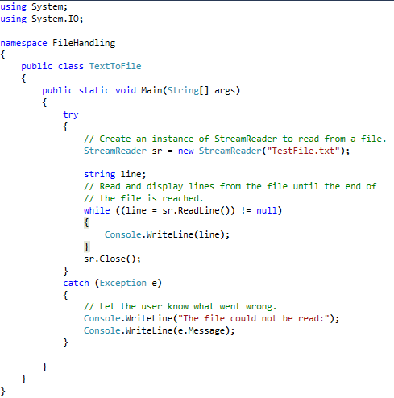
Read from a File: StreamReader class
StreamReader class:
Implements a TextReader that reads characters from a byte stream in a particular encoding.
Notes:
Note:
StreamReader is designed for character input in a particular encoding
Use StreamReader for reading lines of information from a standard text file.
StreamReader defaults to UTF-8 encoding unless specified otherwise, instead of defaulting to the ANSI code page for the current system. UTF-8 handles Unicode characters correctly and provides consistent results on localized versions of the operating system.

Slide 17
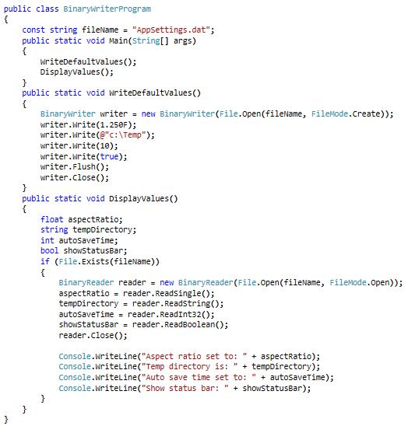
BinaryWriter and BinaryReader
BinaryWriter
1. Writes primitive types in binary to a stream and supports writing strings in a specific encoding.
2. For example, you can use the Write method to write a Boolean value to the stream as a one-byte value.
3. The class includes write methods that support different data types.
BinaryReader
1. Reads primitive data types as binary values in a specific encoding.
2. For example, you can use the ReadBoolean method to read the next byte as a Boolean value and advance the current position in the stream by one byte.
3. The class includes read methods that support different data types.
Notes:
Note:
When you create a new instance of the BinaryWriter class, you provide the stream to write to, and optionally specify the type of encoding and whether to leave the stream open after disposing the BinaryWriter object. If you do not specify an encoding type, UTF-8 is used.
When you create a new instance of the BinaryReader class, you provide the stream to read from, and optionally specify the type of encoding and whether to leave the stream open after disposing the BinaryReader object. If you do not specify an encoding type, UTF-8 is used.

Slide 18
Reference
For different IO classes in .NET, visit the following links:
http://msdn.microsoft.com/en-us/library/system.io.binarywriter(v=vs.110).aspx
http://msdn.microsoft.com/en-us/library/system.io.binaryreader(v=vs.110).aspx
http://msdn.microsoft.com/en-us/library/system.io.directory(v=vs.110).aspx
http://msdn.microsoft.com/en-us/library/system.io.directoryinfo(v=vs.110).aspx
http://msdn.microsoft.com/en-us/library/system.io.file(v=vs.110).aspx
http://msdn.microsoft.com/en-us/library/system.io.fileinfo(v=vs.110).aspx
http://msdn.microsoft.com/en-us/library/system.io.filestream(v=vs.110).aspx
http://msdn.microsoft.com/en-us/library/system.io.memorystream(v=vs.110).aspx
http://msdn.microsoft.com/en-us/library/system.io.path(v=vs.110).aspx
http://msdn.microsoft.com/en-us/library/system.io.stream(v=vs.110).aspx
http://msdn.microsoft.com/en-us/library/system.io.streamreader(v=vs.110).aspx
http://msdn.microsoft.com/en-us/library/system.io.streamwriter(v=vs.110).aspx
http://msdn.microsoft.com/en-us/library/system.io.bufferedstream(v=vs.110).aspx
Notes:
Reference

